Slide 1
This is the first chapter
Notes:
NEW CHAPTER

Slide 2
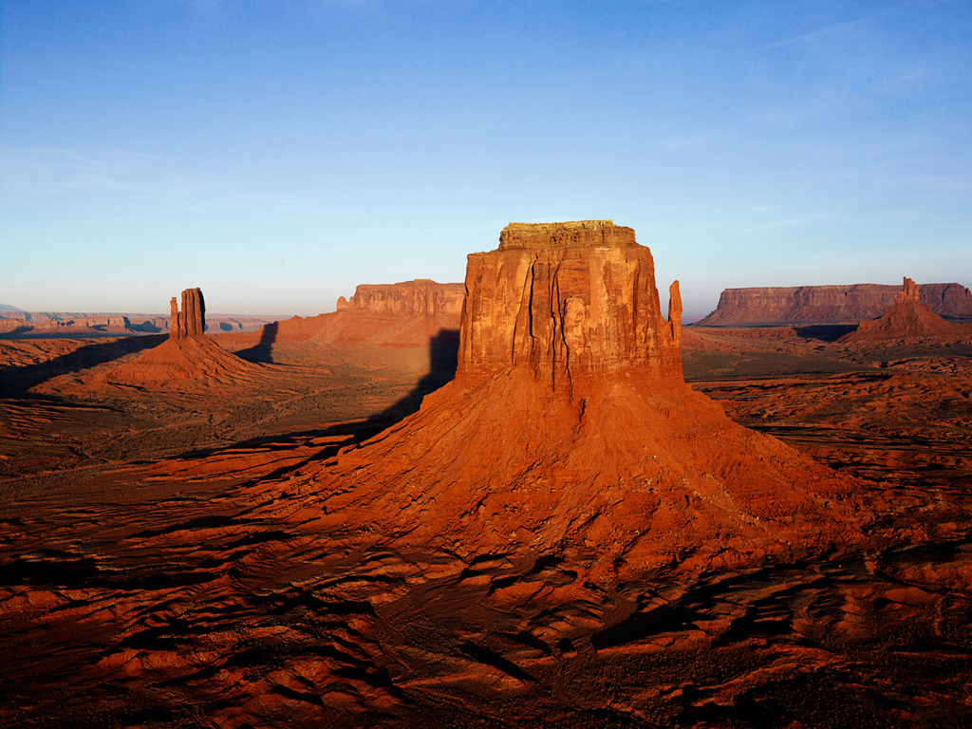
resources/images/Desert.jpg
The images use A rectangle AutoShape and the urlName is wrote into the shape.
Click the desert.
C:\\Users\\Public\\Music\\Sample Music\\Kalimba.mp3
This is a Table which contains the UrlName for music in cell(1,1)
This text box is ignored (no bounding box!)
Shapes are created from a freeform shape
KOALA
Text must be within a “bounding” empty text box with the desired formatting \n (new lines) \n
This is a separate textbody
, Italic/bold/underline\n
Can change on the same line, use
an adjacent text body!
Video is a Chart with a title containing the video urlName
Notes:
Overview of making slides in powerpoint

Slide 3
resources/images/Desert.jpg
Click the sun.
To change the image right click and select format options then select fill from the tabs. \n\n
Select picture as the fill type then find an image in resources taking note of the file name.
Specify the file path by right-clicking the image and edit the text (click edit text) to resources/images/YourImageName.jpg
Notes:
How to make images

Slide 4


To create a Shape you must use the freeform shape tool which can be found in shapes. \n
The icon looks like this!
Dice10.png
Draw with as many points as you like then double-click to finish the shape.\n
You can edit the shape accurately by right-clicking on it and selecting edit points
Dice1.png
Click Here
when you are ready
to continue onto text
Notes:
How to make shapes

Slide 5
The Text requires multiple text boxes, a bounding text box which contains no text at all but contains all the text body sections
Adjacent text bodies must line up to ensure the correct ordering
The text body sections should be text boxes
Aligned to the left and top edge of the bounding box or the previous text body.\n
The bounding box should if possible have extra space below the text bodies to allow for text enlargment
Text body 1
Text body 2
Text body 3
Text body 4
The text formatting (size, font and colour) must be set on the bounding box which can be done easily if you select all boxes by dragging and set the formatting\n
Bold, Italic and Underline are set seperately for each text body based on the first characters formatting
Bounding box
Notes:
How to make text areas

Slide 6
The Music is incorporated using a table in which the cell(1,1) is the urlName of the music
C:\\Users\\Public\\Music\\Sample Music\\Kalimba.mp3
The Video is similar but uses a chart in the title set in the Alt text section of the Format chart area menu. To change this right-click and select format chart area.
Click Here
when you are ready
to return to the overview
Notes:
How to add music and video

Slide 7
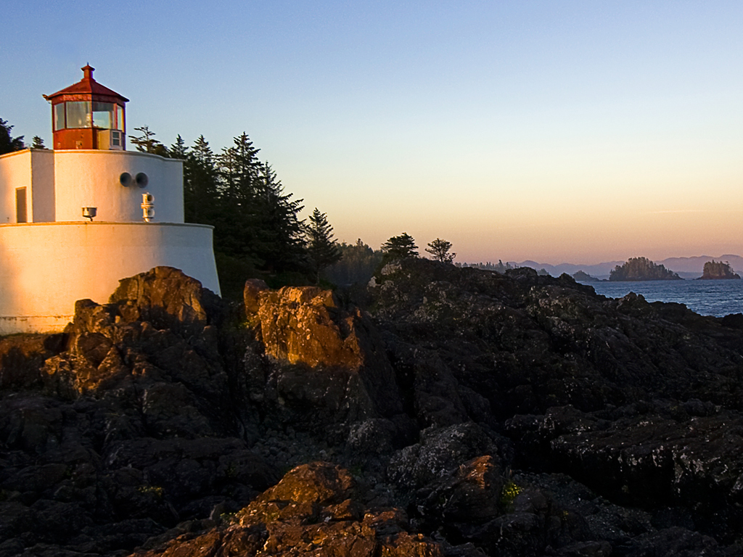
resources/images/Lighthouse.jpg
DRAGON
Notes:
Fun Dragon!

